Slide 1


Business Nuggets:
Frameworks &
Best Practices to
Achieve Success

Slide 2

Our Agenda
01
From Brainstorming to Value Proposition
02
Business Model Canvas and Business Model
03
Marketing and Lead Generation
04
Road Map and Maturity Strategy
05
Attracting Investment
06
Conclusions and Q&A
Notes:
Refa acest slide

Slide 3
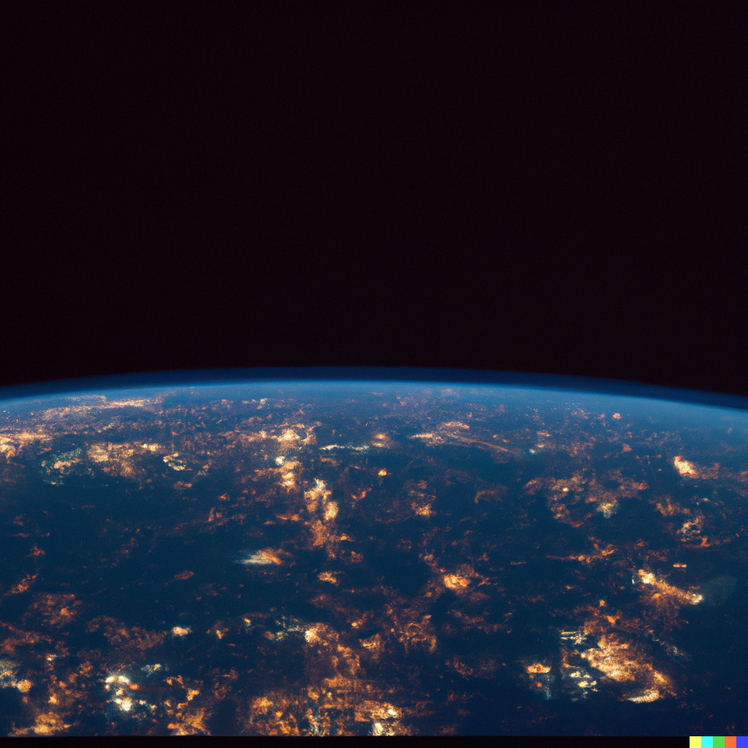
Business in Tech is the Engine of
Innovation, Drive, and Development
To achieve Groundbreaking Solutions
That will shape our Tomorrow
#BusinessDevelopment
#TechOfTomorrow #ThanksForTheThoughtsChatGPT
Notes:
* Generated with DALL-E

Slide 4

Brainstorming Methods
Framework Overview:
We are identifying what to do, how, and why to do it through various steps to develop a good and also analyze our competition
Components:
1
Design Thinking
2
Competitive Enviroment Matrix
Market Analysis Blue Ocean Analysis
3
4
Value Proposition
Key Highlight:
Focus only on what is most essential and what differentiates you from your closest competition
Significant Metric:
A significant number to shock your investor and have a reasoning behind it
Eg: Break Even in 1.2 years, on an initial investment of 1.3M EUR and no longer than 2
Notes:
* Generated with MidJourney Significant metric: I would add clear metrics win credibility: ex: break even in 1.2 years, on a initial investment of EUR 1.3 MM and a pay-back period of no more than 1.6 years.
Scenarios: optimistic/ neutral/ pessimistic approaches also support a professional touch

Slide 5
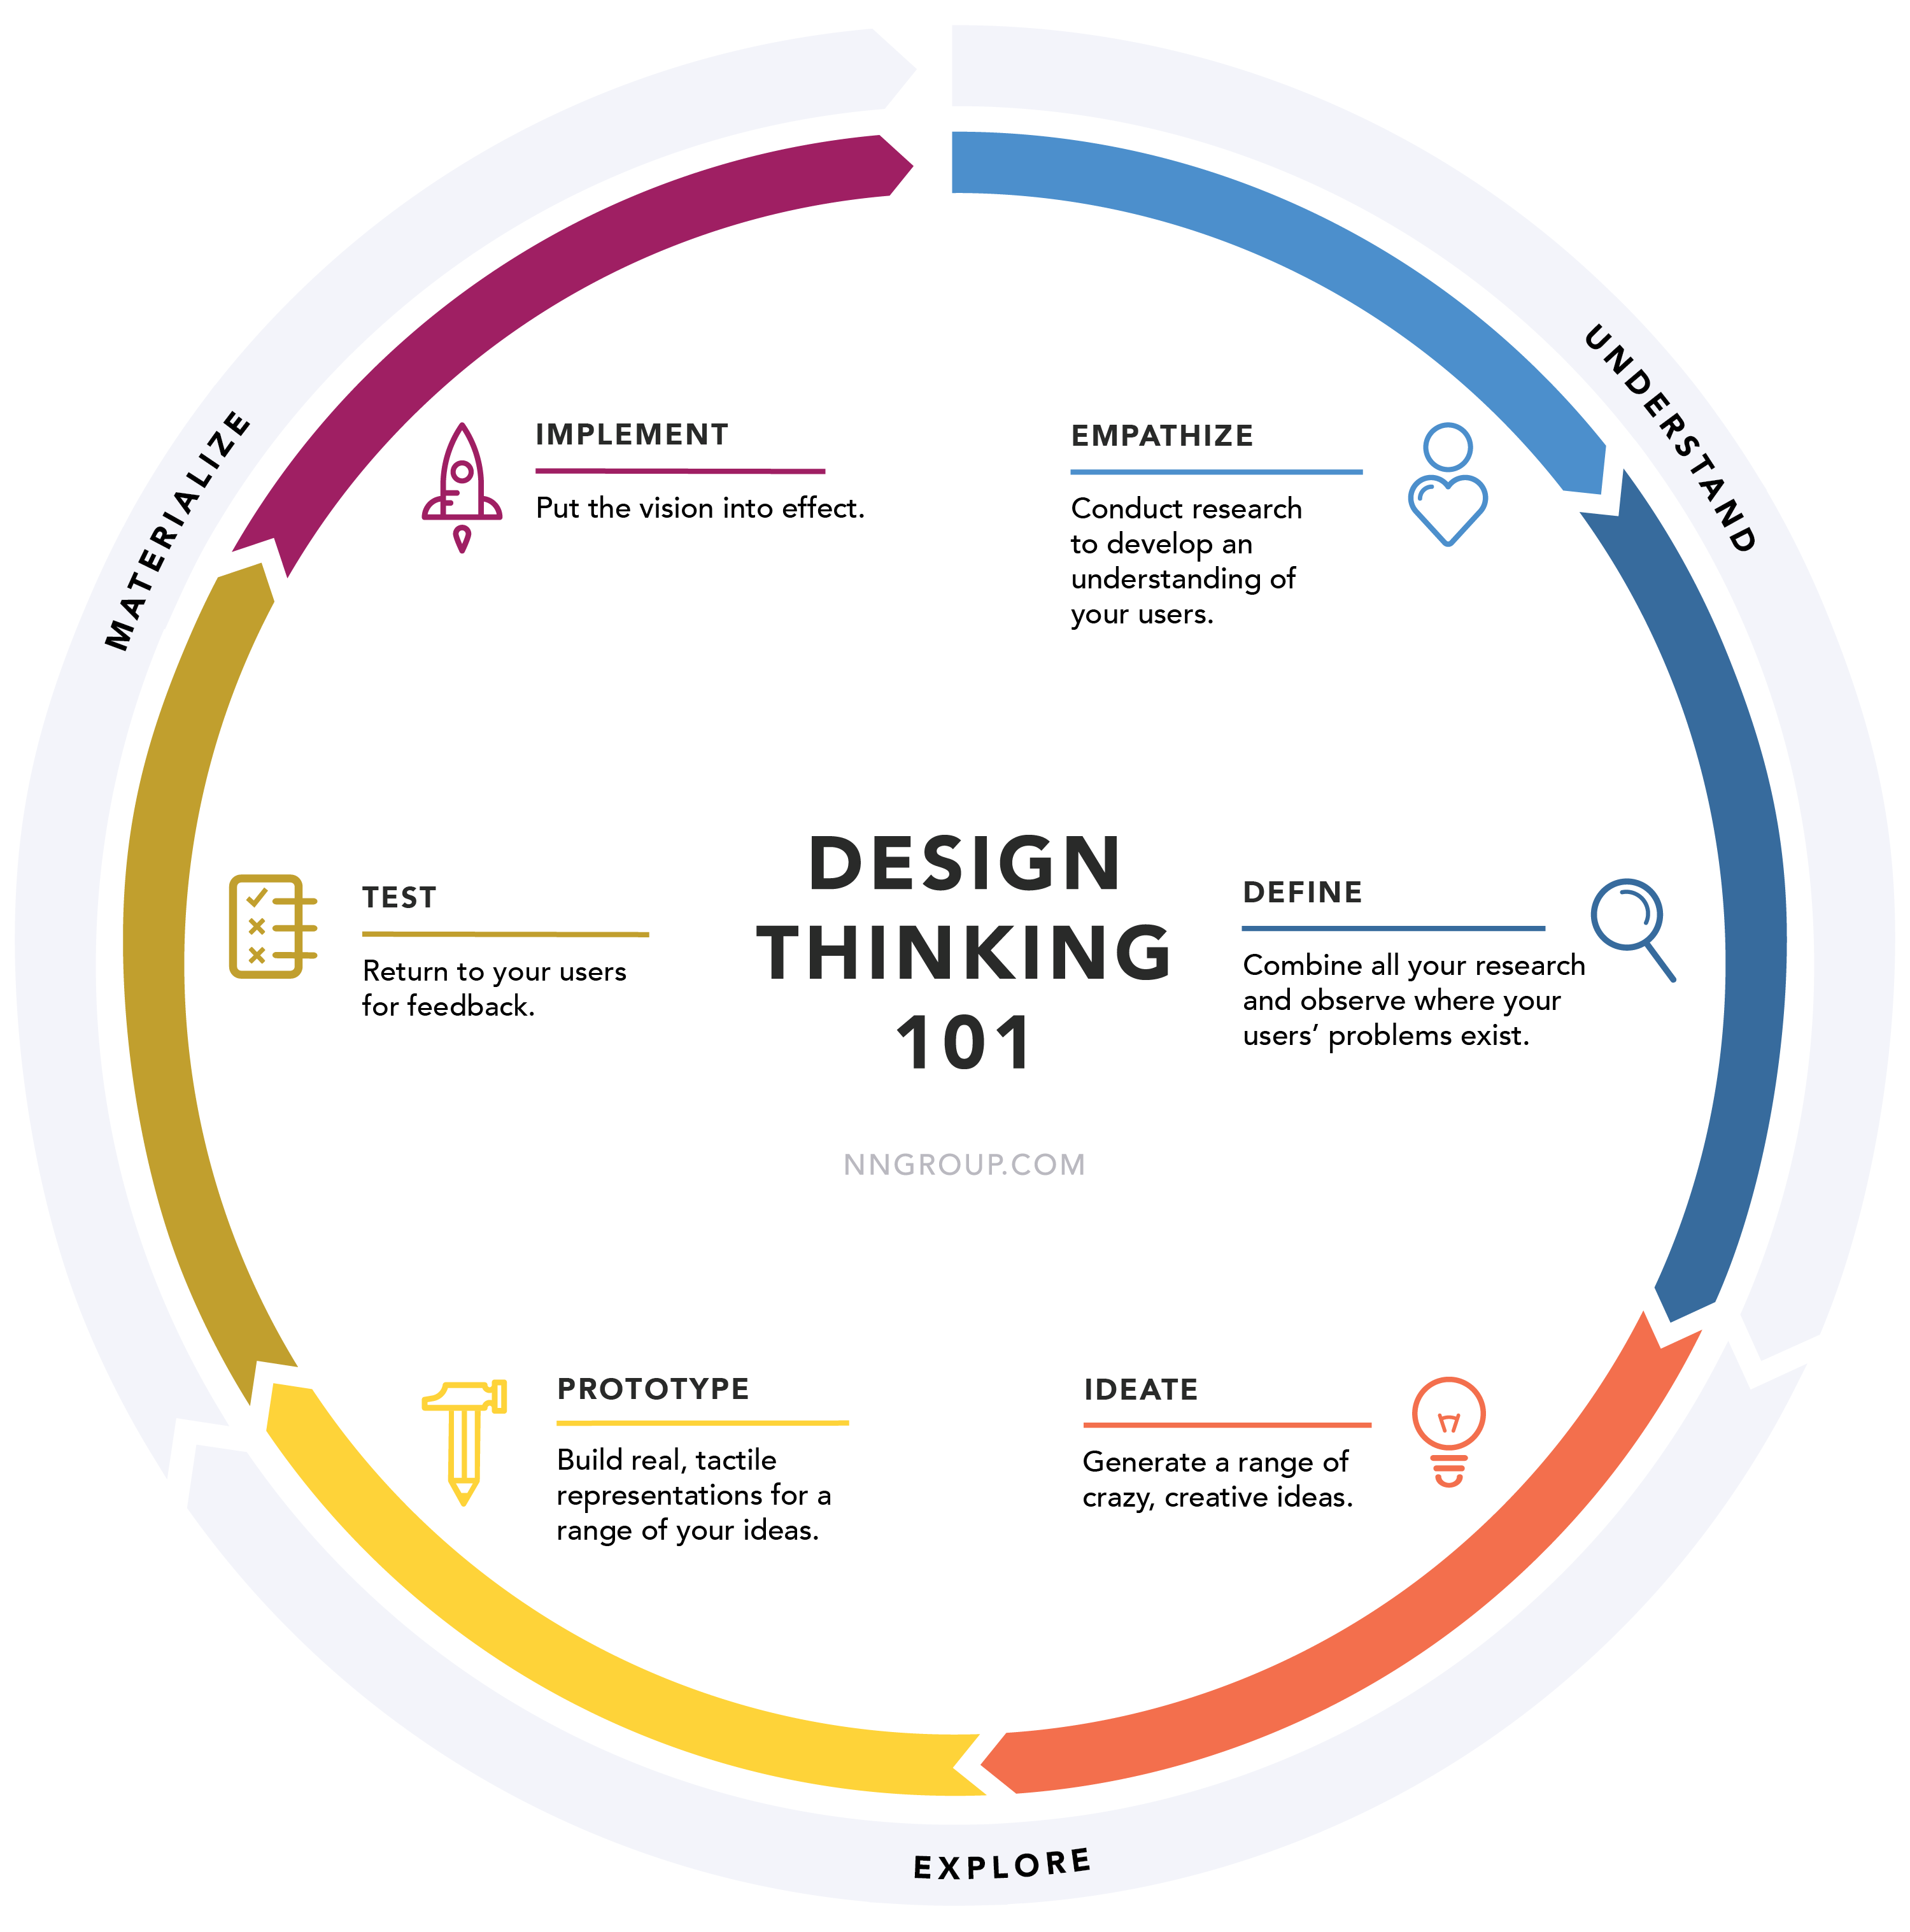
Design Thinking – Easier Said Then Done 💭
6
Easiest Part
1
Forms and Interviews
5
Feels Like it's Working
2
Data Gathering and Analysis
4
Quick and Dirty
3
Vitamin or PainKiller
Notes:
* https://www.nngroup.com/articles/design-thinking/ it’s all about customer centricity, creative ideation, rapid prototyping (pragmatism) and fast iterations.
The critical stakeholders: users, the team, sponsors, tech team, Marketing/ Sales, Externals.

Slide 6
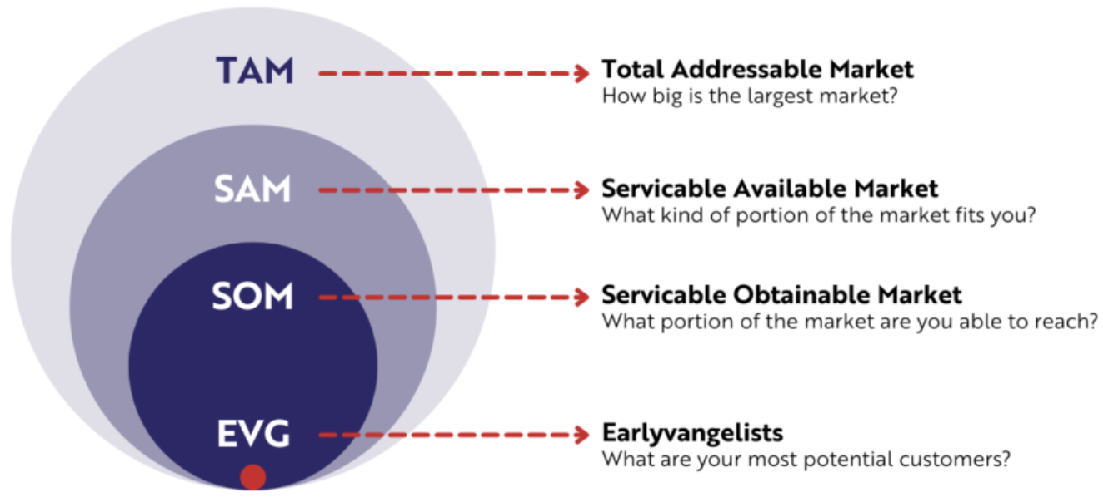
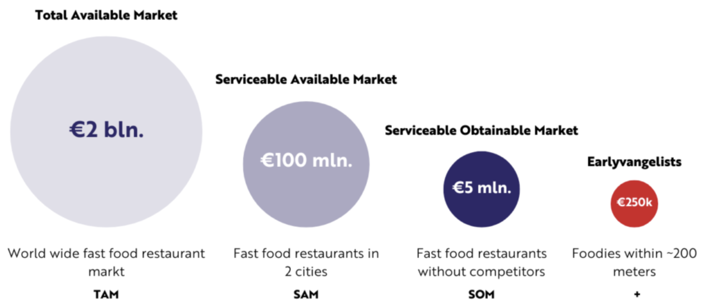
Segmenting the Market 🥧 TAM, SAM, SOM, EVG
Total Addressable Market
How Big is the largest market?
Serviceable Available Market
What kind of portion of the market fits you?
Serviceable Obtainable Market
What portion of the market are you able to reach?
Earlyvangelists
What are your most potential customers?
market
Notes:
* https://gustdebacker.com/tam-sam-som-market/ I would add a couple of go-to free market info sources: McKinsey, Deloitte Insights, Pew Research Center, HubSpot Research, Nielson Insights, Government & trade associations, Industry Reports

Slide 7
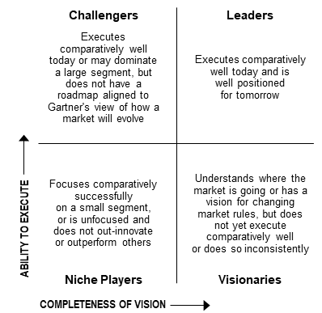
Competitive Analysis – Gartner vs Competivie Matrix 🥶
Company | Trait 1 | Trait 2 | Trait 3 | Trait 4
FacCeva1
FacCeva2DarMaiBine
FacCeva3DarSuperBine
NouaSuperCompanie
Notes:
* https://www.gartner.com/en/research/methodologies/magic-quadrants-research * https://competitors.app/competitive-matrix/ Eu rezonez mai mult cu abordarea in care este important sa rank-uiesti “Traits” in fucntie de importanta pentru client (un level up ar fi si cu valoarea economica).
Ideal, merita sa investesti pentru diferentiere acolo unde este foarte valoros pentru client. Acolo unde este putin important pentru client, opinia mea este jucatorii de success investesc cat sa acopere zona de “igiena”, investitiile peste acest nivel de regula reprezinta un suboptimal use of resouces.

Slide 8
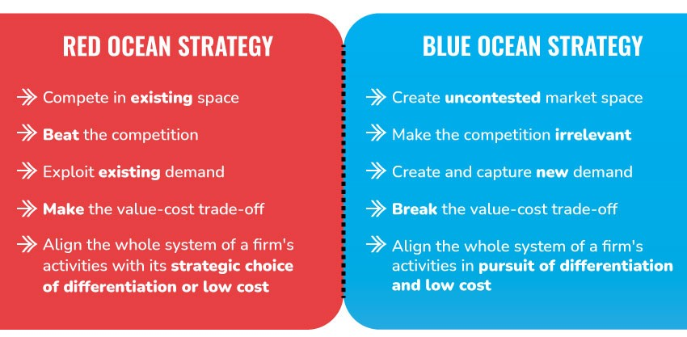
Blue Ocean Quest – Is it safe to swim? Huh, nice 🥹🫶
Notes:
* https://www.linkedin.com/pulse/blue-ocean-strategy-how-peloton-made-competition-prafull-sharma/ I would add examples: Cirque de Soleil, iTunes, Netflix, Dyson (bagless vacuums), Tesla,….

Slide 9

Co-creating value in business model
Transforms customers from passive recipients
To Active Partners
Amplifying Innovation and Engagement
#Co-CreatingValueProposition
#BringValueNotFrictions #ThanksForTheThoughtsChatGPT
Notes:
* Generated with Midjourney

Slide 10

Value Proposition Framework
Framework Overview:
A strategic tool used to clarify and communicate the unique benefits and value a product or service provides to its target customers, distinguishing it from competitors
Components:
1
Our Customer
2
Benefits
3
USP - Unique Selling Point
4
4
Offering
Key Highlight:
Try to focus only on what is most essential and that different you from your closest competition
1
2
Example :
We will aid non-athletes assess their level of preparation and treat themselves by providing a fast and conveninent platform for sport therapy and maintenance
3
4
Notes:
* https://www.wordstream.com/blog/ws/2016/04/27/value-proposition-examples

Slide 11
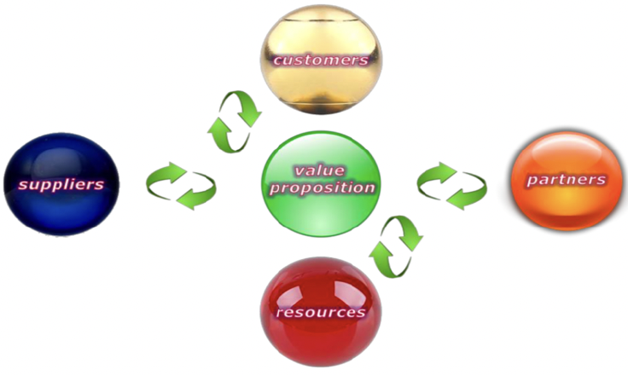
Business Model as Value Co-Creating Interaction System
Be Different and Thinking Fair, all Parties Should Win 💪
Notes:
* https://www.linkedin.com/pulse/blue-ocean-strategy-how-peloton-made-competition-prafull-sharma/ In masura in care nu ai deja asta in partea de speech, as aduce si aici exemple concrete de co-creating business models:
Open-Source Software Development;
Open APIs
Crowdsourcing innovations
Community based product testing
User Generated Content platforms (YouTube)
Co Design (Lego)
Open Banking (Investment Open Platform Saxo Bank

Slide 12
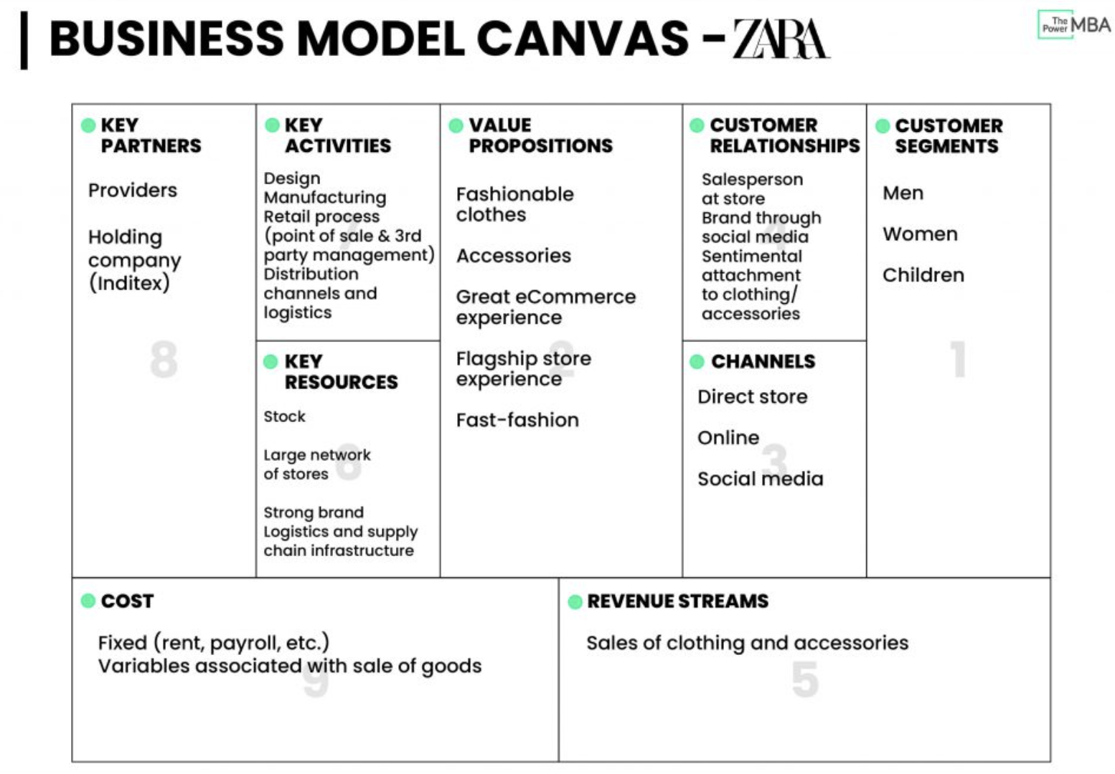
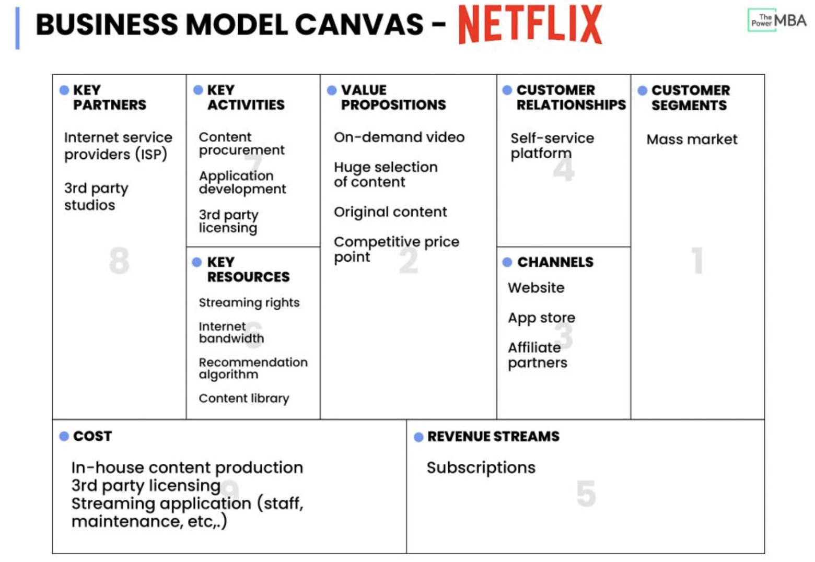
Business Model Canvas What if Zara was a on-demand Streaming Platform? 🧐
Notes:
*https://www.thepowermba.com/en/blog/business-model-canvas

Slide 13

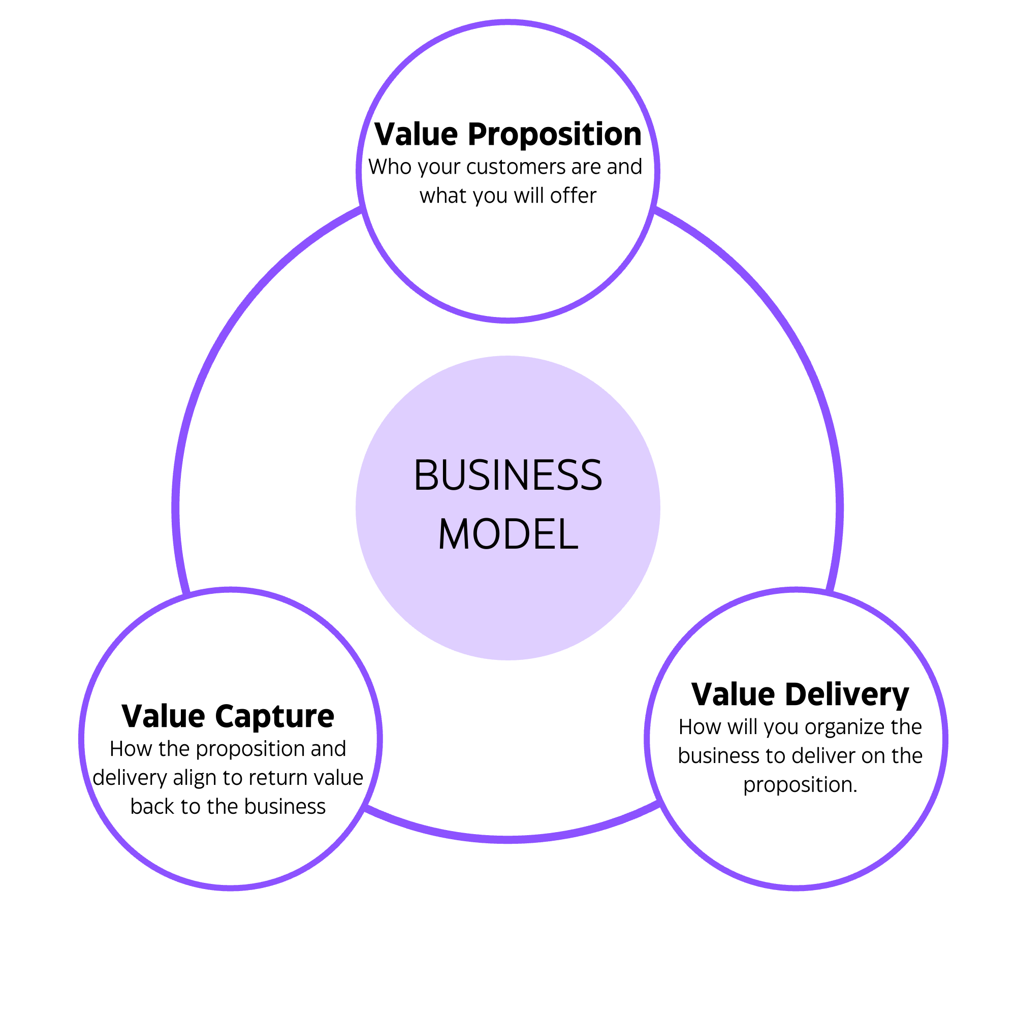
Business Models – Can I sell Burgers that’s it?
Simple Examples:
B2C, B2B, B2G, C2C, C2B,
G2B, G2C, C2G
C- Customer; B- Business; G - Government
Note: To be honest, imagine each scenario
Complex Examples:
Subscription Model
Freemium Model
Product as a Service(PaaS)
E-commerce
Advertising Model
Peer-to-Peer(P2P) etc.
Note: Whatever you choose it is important to try to Propose Value by thinking how to Deliver Value and then to Capture Value again and again. Once one element is shattering it is time to go back to the Drawing Board
Notes:
https://medium.com/@eSamurai/what-are-the-b2c-b2b-b2g-c2c-c2b-g2b-g2c-b2g-c2g-business-types-of-e-commerce-d8fa28718c21
https://www.5paisa.com/finschool/business-models-types-examples-and-importance/

Slide 14

Your Marketing should prioritize
The Big Impact of Small Projects,
Turning Niche Innovations
Into Must-Have Solutions
#KnowYourPrice
#SellingShouldBeEasy #ThanksForTheThoughtsChatGPT
Notes:
*

Slide 15
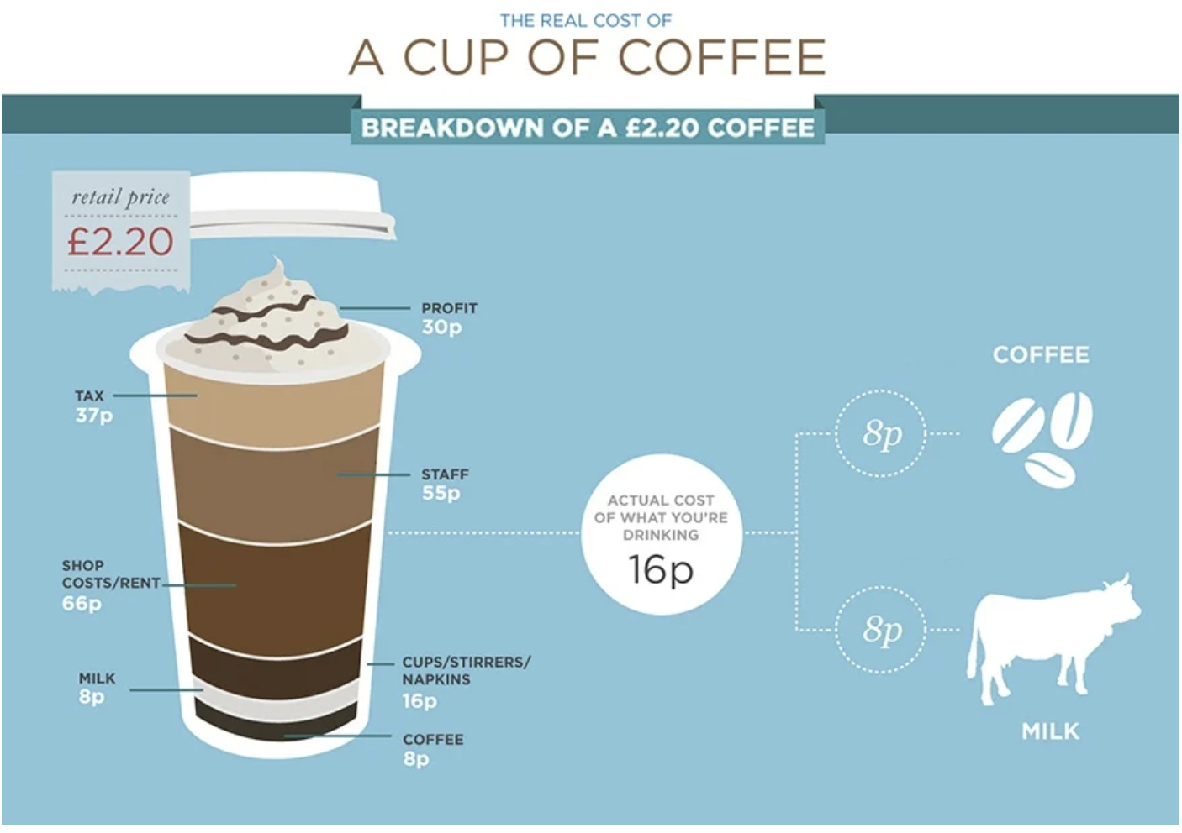
How To Compute the Price Why ☕️ is so expensive? Oh It’s just Today’s Economy
Notes:
*https://blog.wmf-coffeemachines.uk.com/what-goes-into-the-cost-of-a-coffee

Slide 16
The 4 Ps Of Marking Mix 🛒 I see what marketing is all about, but how does it work?
Marketing Mix
Product
Price
Place
Promotion
Variety,Colors and Sizes
List of prices
Physical and online channels for service
Visual identity of product and categories
Quality, Design, and Brand
Discounts
Business reach area
Production of online content
Packaging and Feature
Terms and means for payment
Location of stocks
Guarantees, Exchanges and Support Service
Press office
Cost vs. Benefit compared to the market
Distribution and transport of goods
Disclosure advertising
Convenience of Use, Handling and Delivery
Differentiation from local competitors
Customer attraction and targeting
Notes:
*https://www.edrawmind.com/templates/4-ps-of-marketing-template.html
*https://www.campaignmonitor.com/resources/knowledge-base/what-are-the-4-ps-of-marketing/

Slide 17
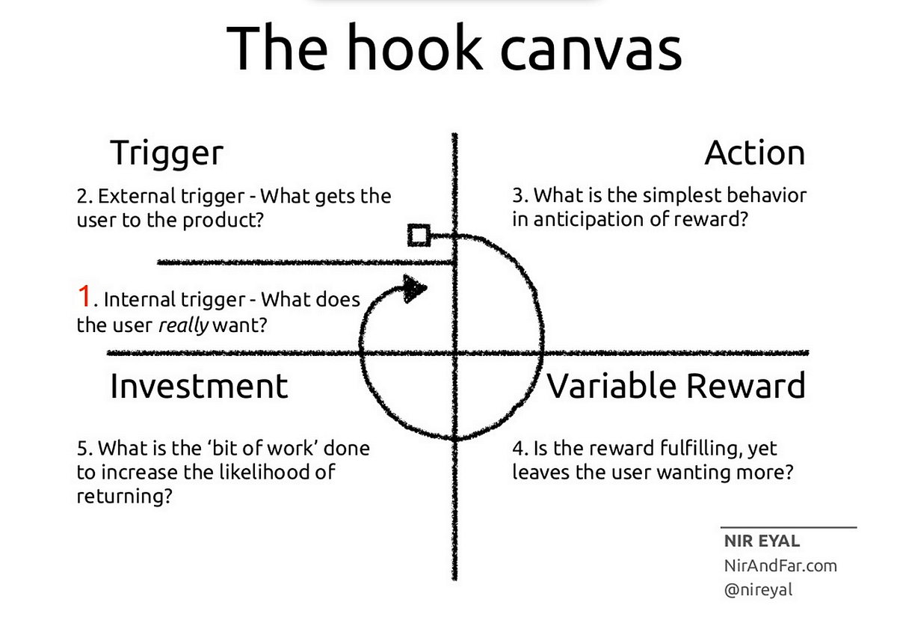
Captain Morgan Theme Song Got Me🪝 I saw your product somewhere, nevermind, I am buying it
Notes:
*https://medium.com/i-want-to-be-a-product-manager-when-i-grow-up/the-hooked-model-fa667c33951d

Slide 18

Your small PoC should strategically scale
Proving Its Market Fit and Potential
For Disruption which can Pave the Way
From Winning a Hackton toward an IPO
#LongRoadAhead
#JourneyHasJustStarted #ThanksForTheThoughtsChatGPT
Notes:
Generated with MidJourney Critical staff:
Clarity (eq: a software tool – integrates smoothly and drives 20% better efficiency)
Scope (start limited, with the most relevant staff)
Success Criteria (ecommerce: user error rate < 5%, customer satisfaction > 80%, drive 20% sales uplift in digital, etc)
Ecosystem/ stakeholders involvement from the beginning (healthtech – include doctors)

Slide 19

Business RoadMap– Can I sell Burgers that’s it?
Stages of Roadmap:
Develop Your Strategic Objectives
Identify Your Audience
Engage Your Stakeholders
Assess Your Capabilities
Identify Your Gaps and Opportunities
Priorities Your Recommendations
Develop Your Timeline
Note: Please Start Simple and make every piece of the puzzle fit
Challenges:
Objectives are hard to define
Audience is always different
Find a Bridge between Parties
Plans suffer changes, and also good parts
Pivot or Integrate
Back to the Drawing Board
One last thing: Crayon your story as easy as possible and then make it complex
Notes:
https://medium.com/@eSamurai/what-are-the-b2c-b2b-b2g-c2c-c2b-g2b-g2c-b2g-c2g-business-types-of-e-commerce-d8fa28718c21
https://www.5paisa.com/finschool/business-models-types-examples-and-importance/

Slide 20

Example Trials Timeline
Future Experiments Implementation
Building Up
The Hype
Team Trials and
Feedback Gathering
Evaluating the Results and
Documentation
MONTH 1
MONTH 1-2
MONTH 2-3
MONTH 4-5
Gather info from the team
Synchronize on different tools
Choosing a suite of tools and exploring their capabilities to the fullest
Have Demo Sessions with different parts of the company
Continuously gather new information and pains/needs
Find a suitable small project where to use the tools day by day
For multiple sprints, try to use the tools
Share feedback with the project team
Find new ways to use the proposed suite
After gathering information and trials, the project team should find the right metrics to evaluate the aiding tools suite.
Expand the Confluence pages with the data available.

Slide 21
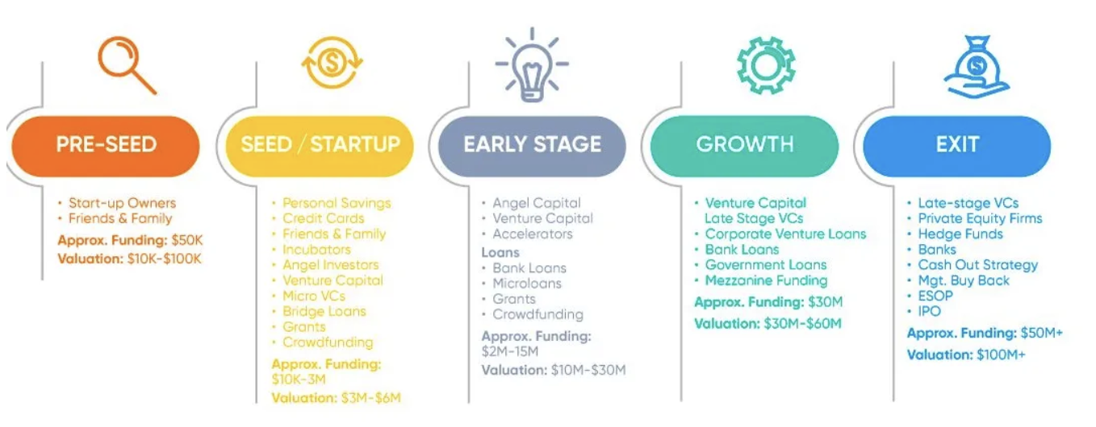
Hum, so what’s next after the Hackaton? Brilliant Idea, but no Money 😿
Notes:
*https://medium.com/@r.b.srikanth/startup-funding-strategies-db69bdecf498

Slide 22
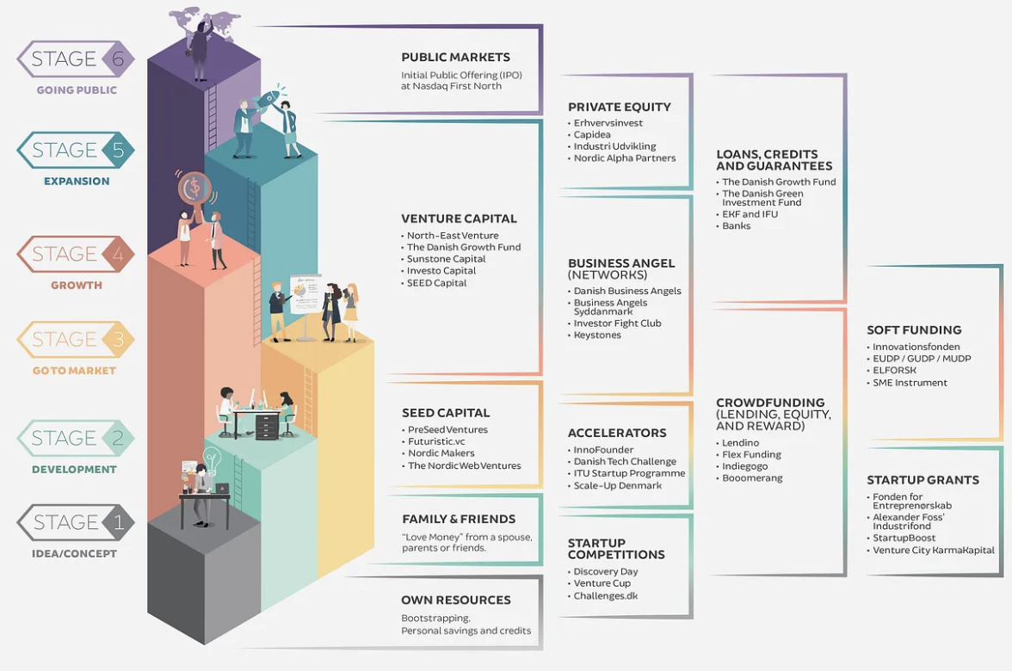
I have seen the steps, but what is an Angel Investor? Will let me see what’s here 🤭
Notes:
*https://medium.com/@InnoOverblik/a-guide-to-startup-funding-sources-in-denmark-ca73ed29b41d
Practical Community support: Founders’ Institute, Tech Hubs and Incubators, UIPath Foundation, Step FWD, BCR InnoviX, Howtoweb, SeedBlink, Weronin (in autorizare) + international: Seedrs, Kickstarter, Indiegogo
What are the investors looking for: Team, Market Opportunity, Business Model, Traction and Scalability, Financials (Know your staff!!!), Competition, Legal, Exit Strategy

Slide 23

Conclusions 🚀
1
Many Ideas, only some are Great
One can try to comprehend the problem, but some might the idea must be validate
2
Market Seems Big
You might think wide, but end up with a niche non-lucrative market and full of players
3
Business Model is as Important as Tech
Why do something that brings no value? Well, find the worth of your own work
4
Marketing is Underrated
If I cannot close deals on a regular basis I will not achieve my target and the company will close
5
Reaching Maturity is the Hardest
From Simple RoadMaps to IPO is a long and complex process; buckle up
Notes:
* Generated with MidJourney

Slide 24

Time To Ask
Is it Easy to Make Money?
🤑 💸 💹

Slide 25

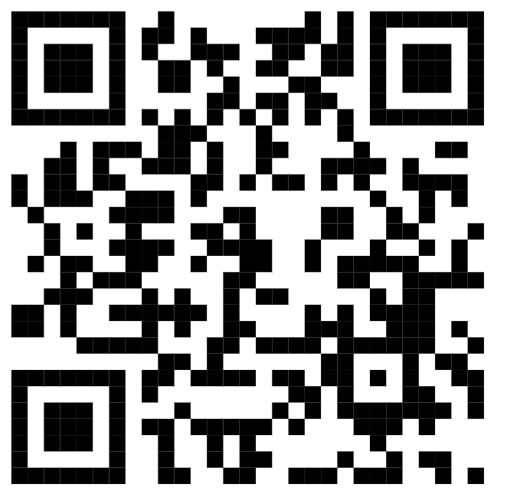

Thank ”U”
Dan Toderici
In Case Of Emergency Contact Me
Astronaut From Neptune
Notes:
* Generated with MidJourney

Slide 26



Also look for us
finshapers for help
Bianca Szekely
Andreea Rautescu
Andrei Nut
Business & HR
Backend Developer
Backend Developer
Notes:
* Generated with MidJourney

